Slide 2
Restoring Your
Financial Storehouses
Live Online Workshop
Copyright © 2021 Doug Addison
All Rights Reserved
DougAddison.com

Slide 3
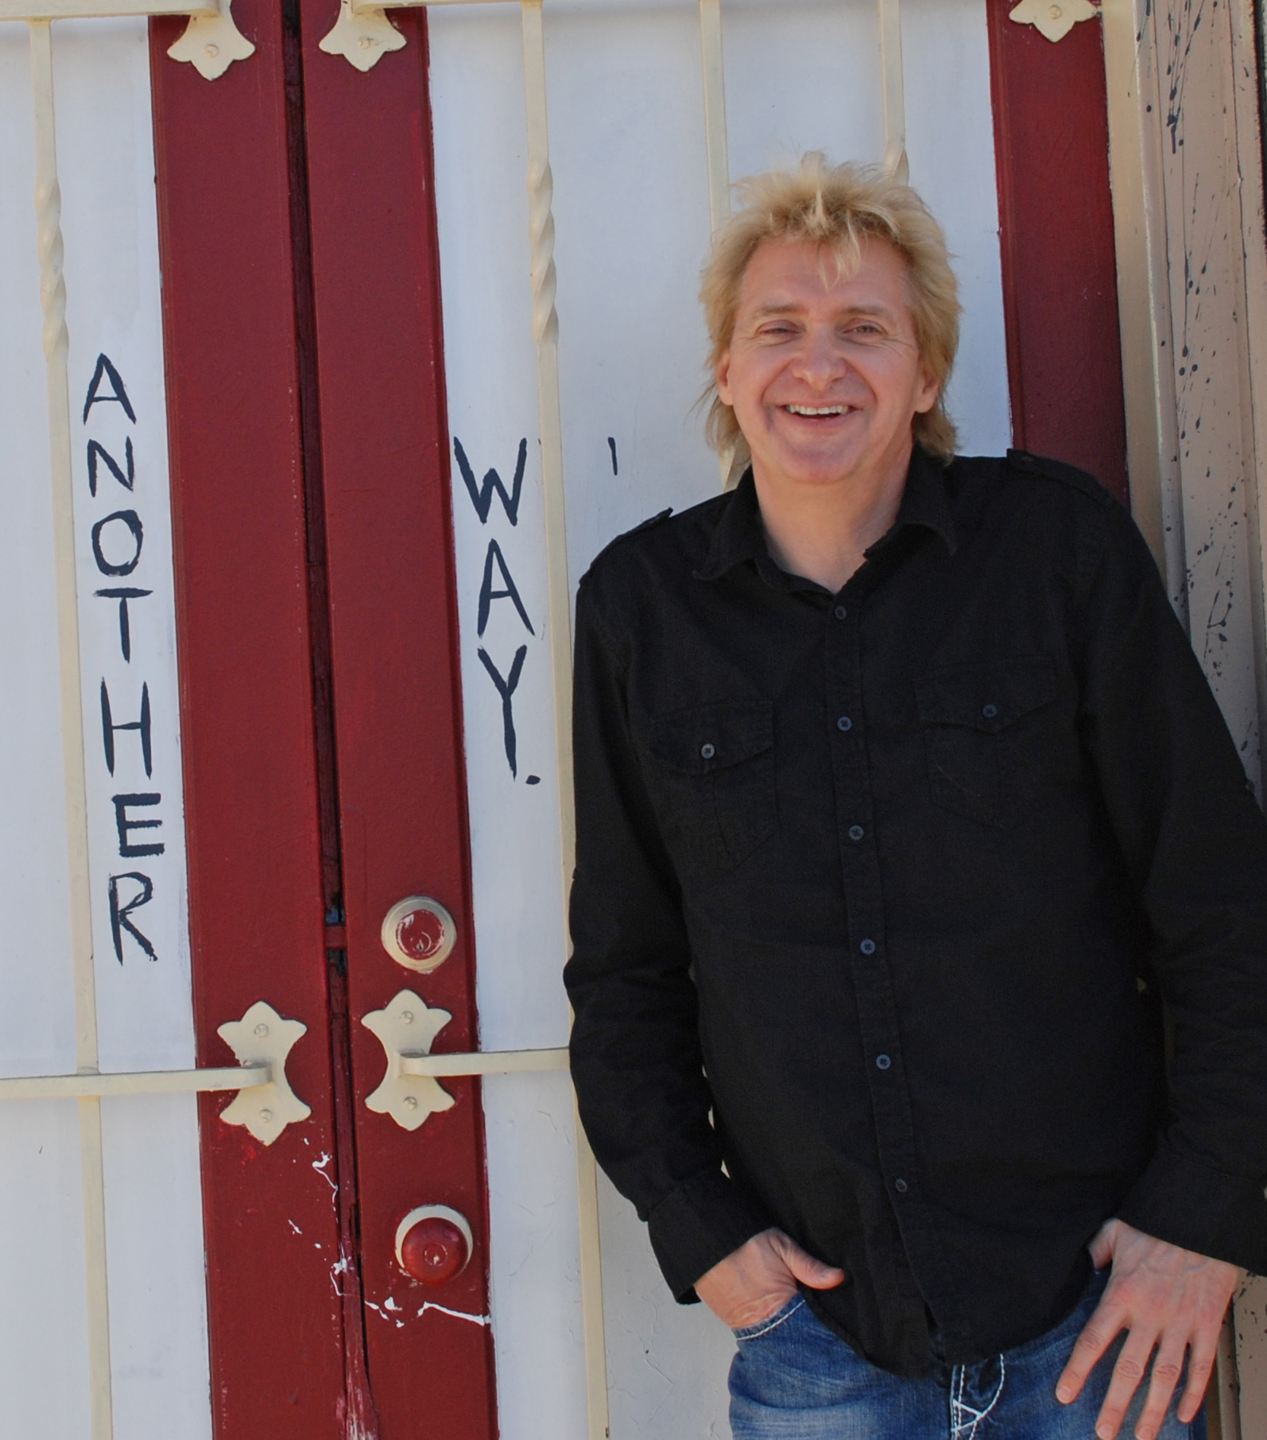
Doug Addison
Doug Addison is a prophetic speaker, author and coach. He is known for his Daily Prophetic Words, Spirit Connection podcast, and blog.
Doug's message of love, hope and having fun reaches people around the world! His powerful, positively funny teaching style and coaching helps open people to discover their destiny and experience God's supernatural love and power.
He and his wife Linda live in Los Angeles, California, where they are impacting the arts, entertainment and media industries.

Slide 4
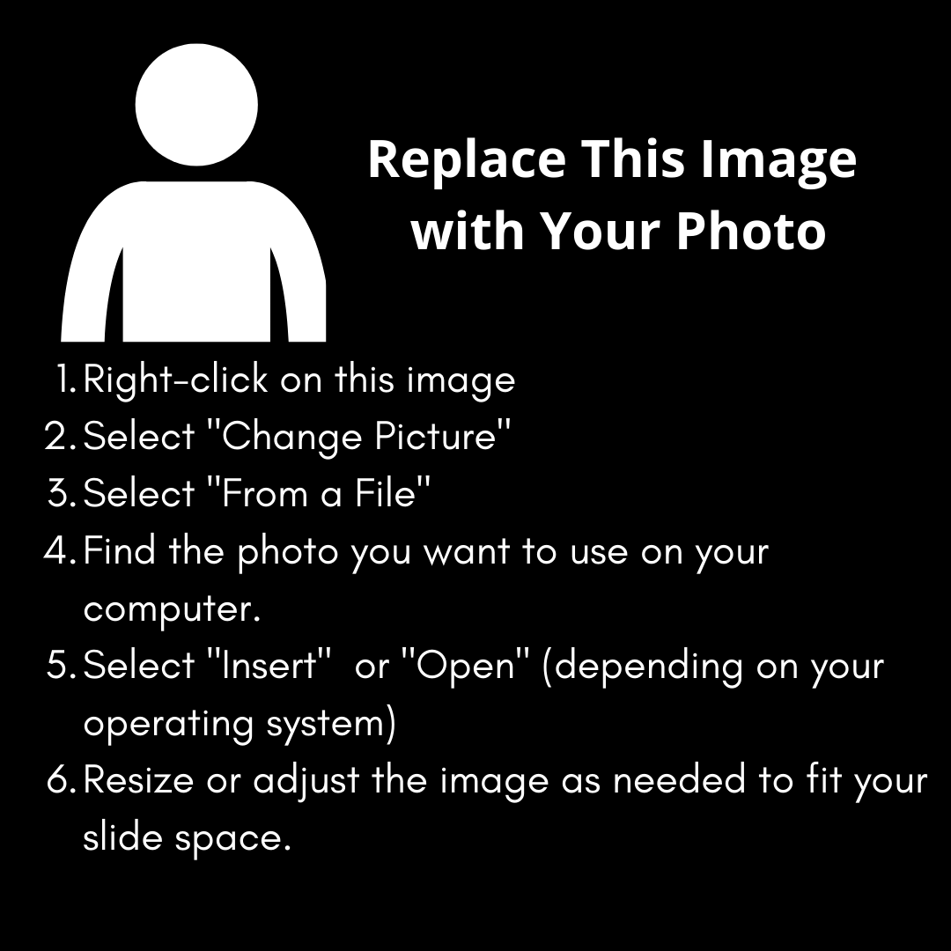
Trainer Name
Insert your trainer bio in this space, and your photo to the right.
…
…
…
…
…
…
…

Slide 5
What You Can And Cannot Do With The Notes
You can learn from them and share what you learn with others.
You can quote from the material and use sections in your own blogs and teaching. Kindly give Doug Addison credit because it is copyrighted material.
If you have purchased the Trainer Kit, you may use the resources provided with your purchase to train this material in your church, small groups, or online. Please refer to the Workshop Trainer Guidelines for additional considerations. Doug Addison’s name must remain intact on training materials and presentations.
You CANNOT: reprint or use this information in written form without permission from InLight Connection.
    Please do not repost this material on the internet or give it away to others, thanks!
Copyright © 2021 by Doug Addison | DougAddison.com

Slide 6
What We Will Cover
      Solid biblical teaching on money and finances
      Breaking off the spirits of poverty and debt
      Help for those who are sowing but not reaping
      Overcoming Greed, Pride and Mammon
      Financial strategies from the Bible
      Biblical financial principles that will change your life
      How to change the spiritual atmosphere over your finances
      How to get out of debt and stay out
      Ideas to increase your income and cash flow
      How to become the lender and not the borrower
      Practical strategies to increase your finances
      Getting started on your financial breakthrough
      Activation Prayer
      Q&A time, so put in your questions

Slide 7



Slide 8
Open The Storehouses Of Blessings
Prophetic word for now!
The Lord will open the heavens, the storehouse of his bounty, to send rain on your land in season and to bless all the work of your hands. You will lend to many nations but will borrow from none. Deuteronomy 28:12 NIV
There will be a release of financial blessings and plans from Heaven on how to increase your finances for yourself and to help others.
Watch for the Lord to release financial blessings in unusual, unexpected and exciting ways.
The Lord is opening the “storehouses of Heaven” because the storehouses on Earth have been depleted.

Slide 9
Doug Addison’s Background
Doug is a seasoned prophetic minister with a unique gifting to hear the voice of God and develop strategies and solutions.
He was a business owner, pastor, church planter and a forerunner in the entrepreneurial prophetic anointing—which uses business abilities to generate financial blessings for the Kingdom of God.
He worked in the corporate world in banking and information systems.
The Lord shifted his career to consulting, and later to internet business and ministry that opened up freedom of time and money.

Slide 10
Hearing God Is A Major Key
He replied, “Because the knowledge of the secrets of the kingdom of heaven has been given to you, but not to them.” Matthew 13:11 NIV
How many of you want to have the mysteries the secrets of the Kingdom of Heaven revealed to you?
The kingdom of heaven is like treasure hidden in a field. When a man found it, he hid it again, and then in his joy went and sold all he had and bought that field. Matthew 13:44 NIV
Prayer: Lord, reveal the mysteries and secrets of the Kingdom and hidden treasure.

Slide 11
God Can Bless You In Any Season
Isaac planted crops in that land and the same year reaped a hundredfold, because the Lord blessed him. Genesis 26:12 NIV
This was during a worldwide famine. He received a strategy from the Lord and got a seasonal blessing.
It was opposite to what his father Abraham had done. Learning to hear the voice of God is really important in this season.
There is always a “niche of blessings” to be found in every economic climate.

Slide 12
Finding A Way
See, I am doing a new thing! Now it springs up; do you not perceive it? I am making a way in the wilderness and streams in the wasteland. Isaiah 43:19 NIV
God is making a way through the storm that we are in.
There are new opportunities coming that will radically change the way we do things.
God wants to use people like you and me to bless the world.
We must go through a mindset change and clean up anything with ungodly ties.

Slide 13
Going Beyond “Just Getting By”
And my God shall supply all your need according to His riches in glory by Christ Jesus. Philippians 4:19 NKJV
God is calling us to:
    have enough money to fulfill what He is calling us to do
    help supply the needs of others
    be a blessing to people in times of trouble
    finance the work of God—ministries and missions
    develop streams of revenue to continue to give back into the Kingdom
    positively influence the world instead of responding or reacting to it

Slide 14
So What Is Stopping Us?
Fear and unbelief
If you believe, you will receive whatever you ask for in prayer.
Matthew 21:22
All your prayers might not be answered but the fact is that Jesus talks a lot about unbelief, believing and having faith.
Jesus was not able to do miracles when unbelief was present … or did very few miracles (Mark 6:5).
Unbelief is a major killer of financial breakthrough and miracles in our own lives.

Slide 15
Need To Overcome The Spirit Of Fear
For God has not given us a spirit of fear, but of power and of love and of a sound mind. 2 Timothy 1:7 NKJV
The spirit of fear is not the same as the emotion of fear. However they can be tied to one another.
The spirit of fear can cause you to miss opportunities and block your ability to discern the voice of the Lord.
Prayer: Lord, we bring to You all of the things that are holding us back from getting a financial breakthrough …

Slide 16


Slide 17
The Foundation For Hearing God
I keep asking that the God of our Lord Jesus Christ, the glorious Father, may give you the Spirit of wisdom and revelation, so that you may know him better. Ephesians 1:17 NIV
But the one who prophesies speaks to people for their strengthening, encouraging and comfort. 1 Corinthians 14:3 NIV
Follow the way of love and eagerly desire gifts of the Spirit, especially prophecy. 1 Corinthians 14:1 NIV

Slide 18
Recognize How God Speaks Specifically To You
For God speaks again and again, though people do not recognize it. Job 33:14 NLT
God speaks in a variety of ways. It may be through:
      The Bible – Dreams and Visions – Hearing the Holy Spirit – Interacting with Angels
      Prophetic Words – Nature – Music & The Arts – Seeing, Hearing, Feeling, Sensing, Smelling, etc. The possibilities are endless!
It will benefit you to keep a journal or notes on how you hear God.

Slide 19
Knowing Who God Really Is
Which of you fathers, if your son asks for a fish, will give him a snake instead? Or if he asks for an egg, will give him a scorpion?
Luke 11:11–12 NIV
God is a loving Father who is not out to judge or harm you. He is not angry with you and He longs to relate to you like a father does with his children.
We need to clean up any negative filters that may be clouding your ability to hear the Lord and properly interpret what He is saying.

Slide 20
Recognizing False Voices
My sheep listen to my voice; I know them, and they follow me.
John 10:27 NIV
We can get false voices of God in our minds that are from ourselves (past bad experiences) or the enemy.
Characteristics of the false voices: unloving, harsh and judgmental; angry and disappointed with you; gives you bad intentions towards others; leads to unbiblical behavior.

Slide 21
Renewing Your Mind
Do not conform to the pattern of this world, but be transformed by the renewing of your mind. Then you will be able to test and approve what God's will is—his good, pleasing and perfect will.
Romans 12:2 NIV
We need to renew our minds ... away from the patterns of the world.
You will need to eliminate fear, judgments and unbelief.
Replace these with the fruit of the Spirit (Galatians 5:22–23): love, joy, peace, patience, kindness, goodness, faithfulness, gentleness and self-control.

Slide 22
Steps To Hear God Accurately
Build a foundation of knowing who God is and understanding the Bible.
Be aware that there is a spiritual atmosphere that can be open or closed.
Keep track of what God is saying; research and follow up.
It will take practice to learn to discern, so be willing to be wrong and learn from your mistakes.
Activate what you hear by doing a practical step toward it.

Slide 23

How To Grow In Discernment
But solid food is for the mature, who by constant use have trained themselves to distinguish good from evil. Hebrews 5:14 NIV
      Believe that God wants to speak to you.
      Spend time, regularly, quieting yourself to listen to God’s still, quiet voice.
      Read the Bible so that He can speak to you through His written Word.
      Practice hearing God by asking Him to speak to you and write down what you sense He is saying to you.
      Embrace mistakes as part of your learning process.

Slide 24
More Resources On Hearing God
Workshop: Discern God’s Voice: How to Know You’re Hearing Accurately
Workshop: How to Activate Seeing and Hearing in the Spirit
Book: Hearing God Every Day: Understanding the Supernatural Ways God Speaks to Us
Book: God Spoke, Now What? Activating Your Prophetic Word
Available At: DougAddison.Store

Slide 25


Slide 26
Building Your House On Solid Ground
Therefore everyone who hears these words of mine and puts them into practice is like a wise man who built his house on the rock. The rain came down, the streams rose, and the winds blew and beat against that house; yet it did not fall, because it had its foundation on the rock. Matthew 7:24–25 NIV
Jesus tells us that if we put the Word of God into practice, the things that we do will withstand the storms.
In this session, we are going to look at some solid biblical principles that you will need to build your life on.
For some people this will come easily, or you might need to battle more based on your past or the level of your calling.

Slide 27
The Lord Wants You To Produce Wealth
But remember the Lord your God, for it is he who gives you the ability to produce wealth, and so confirms his covenant, which he swore to your ancestors, as it is today. Deuteronomy 8:18 NIV
It is the Lord’s will for you to be blessed and produce wealth to be a blessing.
Somehow the spirit of poverty came into the lives of Christians.
We need to break out of the spirit of poverty and lack, and step up to be a blessing.

Slide 28
True Wealth Is Not Money
For where your treasure is, there your heart will be also.
Matthew 6:21 NIV
    True wealth and riches is a relationship with God our Father through Jesus (Colossians 2:2–3)
    True wealth is found in the greatest commandment of love
    (Matthew 22:36–40)
    Being rich is not the size of your bank account (Romans 14:17)
As we get healed of the issues of our soul, the Lord can trust us with the true spiritual wealth (gifts and anointing) and financial wealth.

Slide 29
Is The Bible Against Being Rich?
Then Jesus said to his disciples, “I tell you the truth, it is very hard for a rich person to enter the Kingdom of Heaven.” Matthew 19:23 NLT
Jesus was not creating a doctrine that we cannot have money. He was speaking to an individual who had made money his god.
Jesus was not against money and wealth, and He had wealthy people around Him. He talked about having your heart and motives in line with the Lord.
When He cleansed the temple of the money changers, it was their dishonesty that He did not like (John 2:13-16).
Jewish people have this understanding, and they see financial blessing as worship to God.

Slide 30

Money Can Be Dangerous
We need to:
    make sure our heart is in the right place—God will test our motives
    get rid of greed
    deal with over-spending and shopping addictions
    break out of a poverty mindset—realize that “with God all things are possible”
    let go of guilt that says we cannot serve God and have money
    discover the healthy balance that God intended us to have regarding money
    expand our possibilities and get creative so that we can change the world with God’s love!

Slide 31
A Balance Is Needed
For the love of money is a root of all kinds of evil. Some people, eager for money, have wandered from the faith and pierced themselves with many griefs. 1 Timothy 6:10 NIV
One side is poverty and living a life where God’s grace is sufficient.
The other side is getting caught up in the love of money and being motivated by greed and idolatry.
We need to break the spirits of pride, greed and Mammon (serving money) and the spirit of poverty.
We can live a balanced life—free and clear—so God can use us to bless others.

Slide 32
Understanding Biblical Principles
There are principles that run throughout the Bible. These principles are not rules.
They are laws of the Spirit or ways of the Spirit.
              It’s better to give than to receive
              You must give to receive
              Whatever you sow you reap
              The last will be first
              Be humble and God will exalt you
              Love your enemies
Principles of the Bible work no matter who uses them. Many worldly teachings, coaching and business strategies pull on these principles but take out the life source.
A personal relationship with the Lord and the power of the Holy Spirit brings this to life.

Slide 33
The Most Powerful Principle
Jesus replied: “‘Love the Lord your God with all your heart and with all your soul and with all your mind.’ … And the second is like it: ‘Love your neighbor as yourself.’ All the Law and the Prophets hang on these two commandments.” Matthew 22:37–40 NIV
Jesus referred to this as the greatest commandment. It is not just love in general, but the love triune:
                Love God, love your neighbor, love yourself.
As you bring these under the Lordship of Jesus, you will come into agreement with Heaven, and it is the secret to health and wealth—everything flows through this.

Slide 34
The Principle Of Giving
Give, and it will be given to you. A good measure, pressed down, shaken together and running over, will be poured into your lap. For with the measure you use, it will be measured to you.” Luke 6:38 NIV
Giving is the doorway to receiving but there is more to this message.
The Lord wants you to give of your time, money, love and attention.
You will need to give money such as tithes and offerings, but in the new global economy you can ask the Lord where to give.

Slide 35
Tithing Is Powerful
“Bring the whole tithe into the storehouse, that there may be food in my house. Test me in this,” says the Lord Almighty, “and see if I will not throw open the floodgates of heaven and pour out so much blessing that there will not be room enough to store it.” Malachi 3:10 NIV
Tithing is important and it should be given to the places the Lord tells you. We don’t want to rob our local churches.
You can also tithe and give offerings into places that feed you spiritually or are doing things on the Earth that you support.
10% is a baseline for tithing in the Bible. It would be good to try to give more when possible but stay balanced.
It is important to not be legalistic … but don’t rob God.

Slide 36

The Principle Of Seeking God First
But seek first his kingdom and his righteousness, and all these things will be given to you as well. Matthew 6:33 NIV
We must first seek God in prayer on our decisions. When we are tempted to jump into something, slow down and inquire of the Lord.
Ask God:
        If what you are doing is for now, later or not at all
        For the timing of the Lord
        What steps you need to take

Slide 37
The Principle Of Being Proactive
Ask and it will be given to you; seek and you will find; knock and the door will be opened to you. For everyone who asks receives; the one who seeks finds; and to the one who knocks, the door will be opened. Matthew 7:7–8 NIV
Right after Jesus taught on the Lord's prayer, He talked about how to apply and activate what you are seeking.
          Notice Ask, Seek, Knock has an acronym—ASK
He did not say to sit on the couch and wait for the Lord to open the door for you. Although there are times to wait, you can take steps of preparation.

Slide 38


Slide 39

You Have The Power To Change
I can do all things through Christ who strengthens me.
Philippians 4:13 NKJV
But with God all things are possible. Matthew 19:26 NIV
You have access to everything you need to succeed because the Holy Spirit is in you.
      God is for you
      God is not angry with you
      God loves you and desires for you to succeed and to prosper
      God is not punishing you

Slide 40
Common Ungodly Beliefs With Money
        Unbelief
        Poverty spirit
        Greed, Pride and Mammon
        Misunderstanding and misinterpretations of the Bible

Slide 41
Unbelief Is Huge
If you believe, you will receive whatever you ask for in prayer. Matthew 21:22 NIV
All your prayers might not be answered, but the fact is that Jesus talks a lot about unbelief, believing and having faith.
Unbelief is a major killer of financial breakthrough and miracles in our own lives.
Believe that the Lord wants to bless you!

Slide 42
The Spirit Of Poverty And Debt
You earn wages, only to put them in a purse with holes in it.
Haggai 1:6 NIV
Some people focus only on God and don’t care about earthly wealth—some are called to do this. But we can’t all take a poverty vow.
Debt does not necessarily mean you have the poverty spirit.
You might have generational ties or curses that need to be broken.
You might need inner healing prayer to break off strongholds.

Slide 43
Symptoms Of The Poverty Spirit
    In continual debt or have a family history of debt and bankruptcies
    Feel like a victim and seldom take risks
    Jealous or angry with people who have money
    You feel guilty or shameful over money
We will do a prayer later to break the spirit of poverty.

Slide 44
Greed, Pride And Mammon
But those who desire to be rich fall into temptation and a snare, and into many foolish and harmful lusts which drown men in destruction and perdition. 1 Timothy 6:9 NKJV
Be careful not to get caught up in the love of money and being motivated by greed and idolatry.
You might need to get healed of greed, addiction, or poverty and debt, depending on your situation.
For the love of money is a root of all kinds of evil. Some people, eager for money, have wandered from the faith and pierced themselves with many griefs. 1 Timothy 6:10 NIV
Money is not evil—it is the love of money that brings you down.

Slide 45
The Spirit Of Mammon
No one can serve two masters; for either he will hate the one and love the other, or else he will be loyal to the one and despise the other. You cannot serve God and mammon. Matthew 6:24 NKJV
Jesus indicates that Mammon is a god (you cannot serve God and Mammon).
Mammon in the New Testament of the Bible is the worldly connection to money, material wealth, greediness and lust, to name a few.
The 3-cord of Greed, Pride and Mammon is deadly and needs to be avoided and broken.

Slide 46
God Will Use Money To Test You
Whoever can be trusted with very little can also be trusted with much, and whoever is dishonest with very little will also be dishonest with much. So if you have not been trustworthy in handling worldly wealth, who will trust you with true riches? And if you have not been trustworthy with someone else's property, who will give you property of your own? Luke 16:10–12 NIV
If you can be trusted with earthly wealth, then you can be trusted with Kingdom wealth.
Be fair and honest even if it hurts. Dishonesty is listed among the things God views as an abomination.

Slide 47
Being Grateful And Content
I know what it is to be in need, and I know what it is to have plenty. I have learned the secret of being content in any and every situation, whether well fed or hungry, whether living in plenty or in want. I can do everything through him who gives me strength.
Philippians 4:12–13
Contentment and gratitude are keys to the powerful principle of “I can do everything through Christ.”
This will align you with the principles of the Bible and allow you to bless others.

Slide 48
Prayer To Break The Spirit Of Mammon
Lord, we break the ruling spirit of Mammon that Jesus spoke about—serving money as a god and all idolatry associated with it.
We repent for and renounce any generational ties to idolatry, serving money and the spirit of Mammon.

Slide 49
Prayer to Break The Spirit of Poverty
Lord, we repent, renounce and break all curses, including generational ones having to do with poverty and debt. We break off every assignment that is coming against us.
Now Lord, release Your power, anointing and angels over our minds and finances to bring healing and solutions from Heaven.

Slide 50
Prayer to Break the Spirit of Greed
Lord, we break the spirit of Greed and anything associated with it.
Lord, we repent, renounce and break all curses, including generational ones having to do with greed. We break off every assignment that is coming against us.
We now ask that You fill us with Your light and glory. We ask that every good and perfect gift would flow to us according to your Word. Fill us with love, joy and hope in Jesus’ Name.

Slide 51


Slide 52
Practical Steps About Your Finances
Be wise and get advice, especially on big decisions.
Learn to recognize God’s voice. God will guide you and speak to you about your money.
Learn to live within your means and use a budget or spending plan.
Pay off debt and develop savings. (I have a separate get-out-of-debt mini-workshop on the community site if you need it.)
Develop a lifestyle of earning, giving, saving and spending in moderation.
Update your résumé and your skills.
Do your best at your job so if it comes time to cut staff, they will not want to lose you.

Slide 53
Getting Out Of Debt
Let no debt remain outstanding, except the continuing debt to love one another, for whoever loves others has fulfilled the law.
Romans 13:8 NIV
Debt has become a new normal, but we can overcome it.
Break off the shame and come into reality.
Don’t be a victim. You have power to change and get a financial breakthrough. Use the money towards debt reduction or your goals.
Work as a freelancer or take part-time side jobs.
Clean houses, babysit, cook for others, gardening, fix cars, etc.

Slide 54
Dave Ramsey’s 7 Baby Steps
Step 1: $1,000 In An Emergency Fund
Step 2: Pay Off All Debt With The Debt Snowball
Step 3: Get 3 To 6 Months’ Expenses In Savings
Step 4: Invest 15% Of Income Into Roth IRAs And Pre-Tax Retirement
Plans
Step 5: College Funding
Step 6: Pay Off Your Home Early
Step 7: Build Wealth And Give
Dave Ramsey’s website: DaveRamsey.com

Slide 55
Are You Sowing But Not Reaping?
Give, and it will be given to you. A good measure, pressed down, shaken together and running over, will be poured into your lap. For with the measure you use, it will be measured to you. Luke 6:38 NIV
The context is “do not judge.”
Do not judge, and you will not be judged. Do not condemn, and you will not be condemned. Forgive, and you will be forgiven. Luke 6:37 NIV
The solution is to repent for judgments.
Why do you look at the speck of sawdust in your brother’s eye and pay no attention to the plank in your own eye? … You hypocrite, first take the plank out of your eye, and then you will see clearly to remove the speck from your brother’s eye. Luke 6:41–42 NIV
Prayer: Ask the Lord to show you if you have judgments against others and repent. Judgments will block financial blessing.

Slide 56
How To Become A Benefactor
The Lord will open for you His good storehouse, the heavens, to give rain to your land in its season and to bless all the work of your hand; and you shall lend to many nations, but you shall not borrow.
Deuteronomy 28:12 NASB
A benefactor is a person or organization that gives money to others or a cause.
You can start doing this at the level you are right now even if you are in debt.
Put money into a saving account or mark it for the purposes of extra giving
$50 bill giveaway … this can be any amount; ask the Lord who to give it to

Slide 57
Prayer To Open The Heavens Over Your Finances
Lord, we pray that You would open the Heavens over our finances. Reveal any blocks and barriers that could be hindering Your full flow of finances, provision and blessings.
But remember the Lord your God, for it is he who gives you the ability to produce wealth, and so confirms his covenant, which he swore to your ancestors, as it is today. Deuteronomy 8:18 NIV
We pray for the ability to go beyond just getting by, and into a season of producing wealth that will bless the world.

Slide 58
What Are Your Financial Desires?
Write out some bullet points on what you want to do financially. Make more money? Get out of debt? Develop savings, etc.?
Brainstorm this question—you are not committed to doing anything. You just need to get the ideas out.
Write down a list then choose one or two to work on.

Slide 59

One Small Thing Exercise
      Take some time in a place of worship and prayer and get as clear as you can on what you want to do or accomplish.
      Some larger goals might require more time and steps to get there.
      Write down anything you have been feeling you want to do—you don’t have to commit to doing these things.

Slide 60
Decide On Something
What is one decision or task you have been putting off that would change your life in some way if you did it?
Examples: get out of debt; have extra money, get a better job, etc.

Slide 61
Now Take A Step
What are one or two simple steps you can do today that will help you with your new decision?
Examples: write a letter or email to someone; make a phone call; purchase a book, DVD or organizer; do some research on the internet; take a class.
Make sure you are specific and follow through by doing it right now or sometime today.

Slide 62
3 Power Moves For You
You will also declare a thing, and it will be established for you; so light will shine on your ways. Job 22:28 NKJV
      Decree Bible verses that support your goals.
      Take Communion.
      Go on a negative-thought-and-talk fast for the next 21 days.

Slide 63
Bible Verses To Decree
The Lord will open for you His good storehouse, the heavens, to give rain to your land in its season and to bless all the work of your hand; and you shall lend to many nations, but you shall not borrow. Deuteronomy 28:12 NASB
Call to me and I will answer you and tell you great and unsearchable things you do not know. Jeremiah 33:3 NIV

Slide 64


Slide 65
Activation Prayer

Slide 66
Q&A with Doug

Slide 67

break slide

